Slide 1
RL Based Thermal Comfort Controller
Dr. Latif Anjum & Dr. Fahad Iqbal
Dr. Sajid
Dr. Usman
2025 InshaAllah

Slide 2
Feedback on Last Presentation
Comment 1: What if we combine all reward function into 1
Comment 2: Devise different real life scenarios and see if the controller works
Comment 3: Focus on explaining reward
Comment 4: Why stick with PPO? Try other Techniques as well

Slide 3
Key Milestones Achieved
Milestone 1: logged training curve
Milestone 2: reward hyperparameter optimization still in progress
Milestone 3: most related paper using same strategy

Slide 4

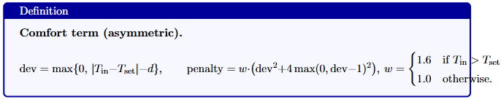
Reward Function

Slide 5
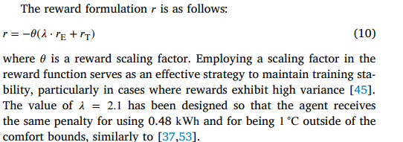
Reward Function latest literature

Slide 6

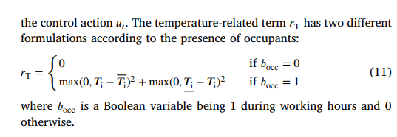
Reward Function latest literature

Slide 7

Paarameter optimization

Slide 8
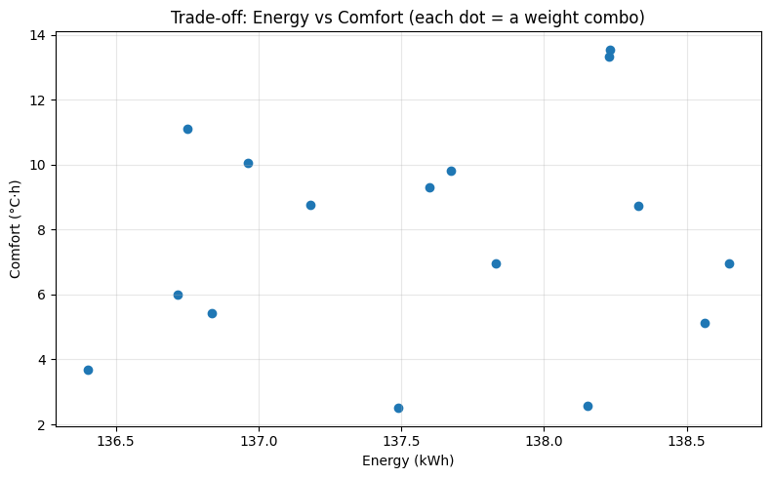
Paarameter optimization

Slide 9
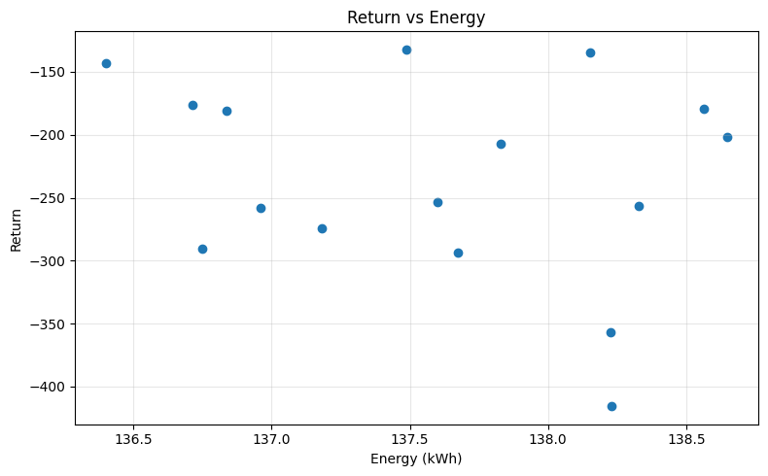
Paarameter optimization

Slide 10
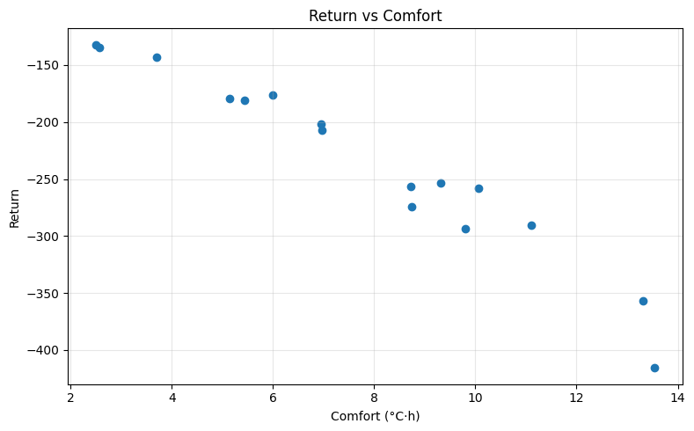
Paarameter optimization

Slide 11
Ranking optimization
No. | Algo | eta_w | zeta_w | lamb_w | steps | Return | Energy_kWh | Comfort_degC_h | Comfort_penalty | Smooth_SumAbsDu | Peak_kW
0 | PPO | 40.0 | 0.2 | 0.03 | 200000 | -132.038771 | 137.488095 | 2.502603 | 1.092160 | 4.101828 | 4.351448
1 | PPO | 10.0 | 0.2 | 0.10 | 200000 | -134.870134 | 138.151100 | 2.572437 | 1.206488 | 4.389699 | 4.434290
2 | PPO | 10.0 | 1.2 | 0.10 | 200000 | -143.252513 | 136.401292 | 3.697974 | 1.693337 | 5.294803 | 4.491379
3 | PPO | 40.0 | 0.8 | 0.05 | 200000 | -176.604312 | 136.715102 | 5.995857 | 3.350580 | 4.412570 | 4.187331
4 | PPO | 10.0 | 1.2 | 0.01 | 200000 | -179.552846 | 138.562570 | 5.137149 | 3.424497 | 4.257044 | 4.415158
5 | PPO | 40.0 | 0.2 | 0.05 | 200000 | -181.055715 | 136.835377 | 5.440943 | 3.569430 | 3.976461 | 4.325323
6 | PPO | 20.0 | 1.2 | 0.10 | 200000 | -201.400963 | 138.648492 | 6.946167 | 4.511395 | 5.085263 | 4.555853
7 | PPO | 20.0 | 0.2 | 0.05 | 200000 | -207.277154 | 137.830264 | 6.961955 | 4.840746 | 3.960628 | 4.376331
8 | PPO | 40.0 | 0.2 | 0.01 | 200000 | -253.729931 | 137.599848 | 9.313322 | 7.168766 | 5.494748 | 4.569174
9 | PPO | 40.0 | 0.8 | 0.10 | 200000 | -256.762971 | 138.329136 | 8.728734 | 7.295993 | 3.595997 | 4.398191

Slide 12

Ranking optimization

Slide 13
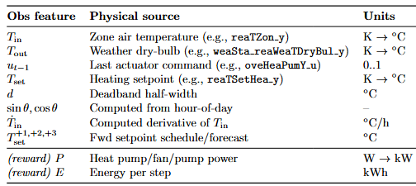
Observation Space

Slide 14
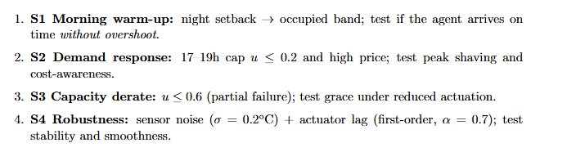
Scenarios

Slide 15
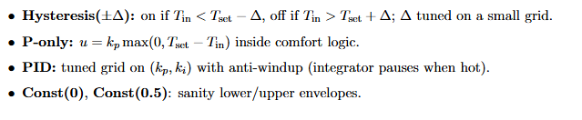
Baselines

Slide 16
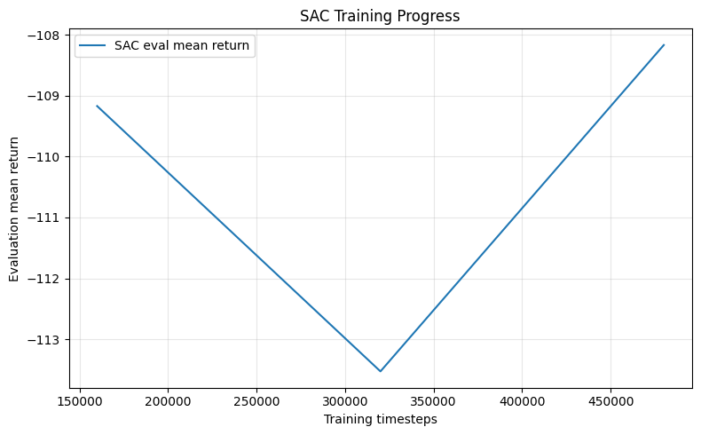
Training curve

Slide 17
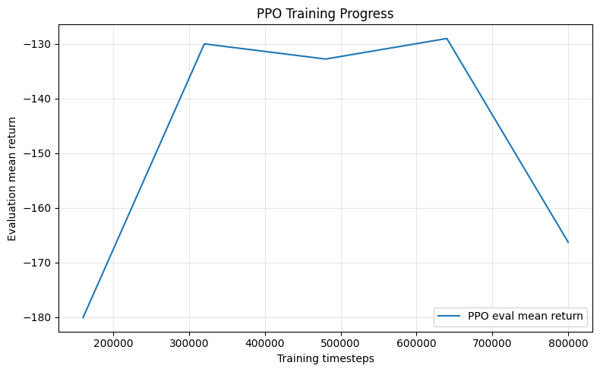
Training curve

Slide 18
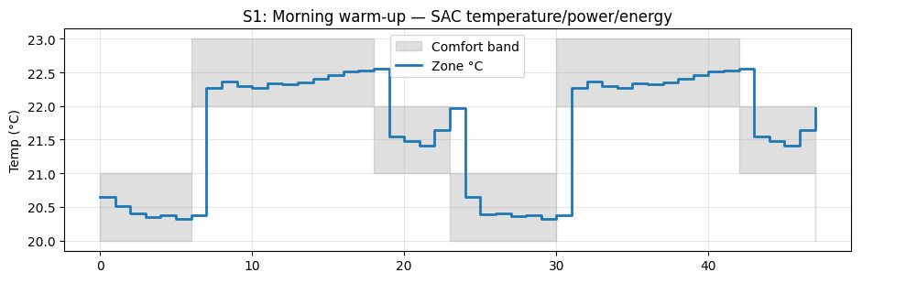
Results S1

Slide 19
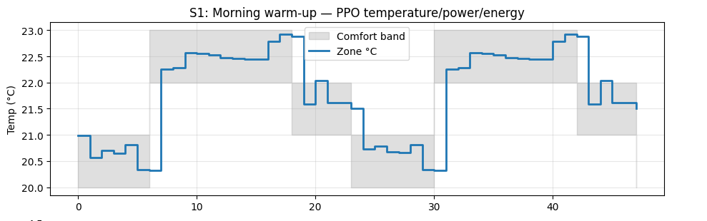
Results S1

Slide 20
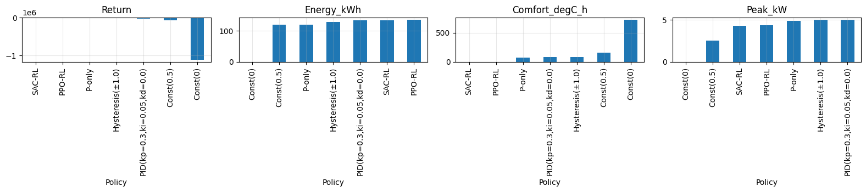
Results S1

Slide 21
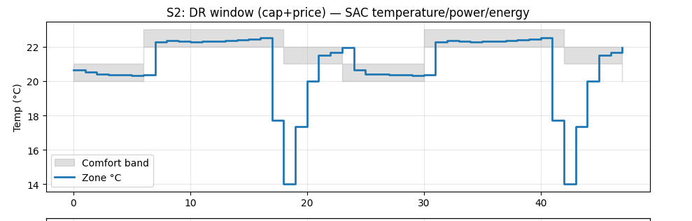
Results S2

Slide 22
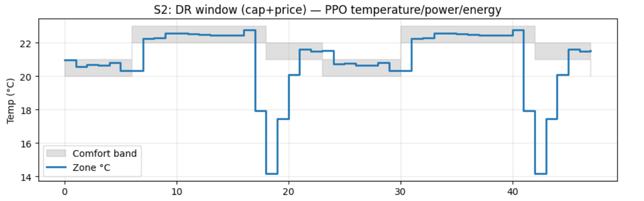
Results S2

Slide 23
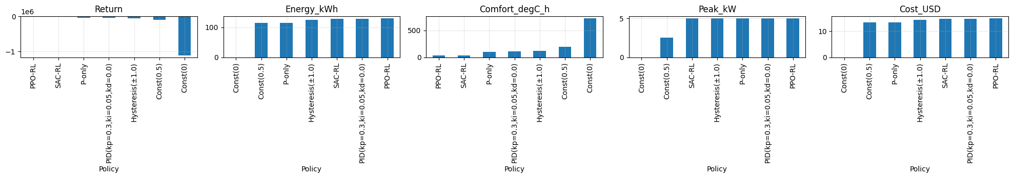
Results S2

Slide 24
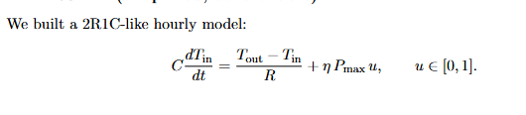
General
To reduce training time the simplest RC house model is chosen
https://ieeexplore.ieee.org/document/10540133/

Slide 25
Plan
Tweek to improve it
Try on other Scenarios as well
Test on other BOPTEST environments

Slide 26
FeedBack- Dr Fahad
Plot return curve between PPO and SAC
Hyperparameter Optimization
Why are there sharp edges in the graph? Oh so that is action may be turn on and off ?
Baseline paper

Slide 27
FeedBack- Dr. Latif
Plot two different controllers on the same plot to see how other controllers are working and how my controller is working.
Develop a script to use different values of hyper parameter to optimize amd find the best one
Compare with most recent approach which in my case is Reward function

Slide 28


